Slide 1

Best Card
Predicting Credit Card Defaults: A Data-Driven Approach for Risk Management
Presented by Team 2: Janice Fong Josh Quintana Melvin Torres Pereira Tanupriya Lakshmi Narayana

Slide 2

Business Problem
Observation
An increasing number of account holders have been failing to meet their minimum payment requirements, leading to a rise in defaults.
Pain Points & Gaps
Higher financial risk & collection costs
Inefficient reactive strategies
Lack of data-driven risk assessment
Notes:
Observation:
An increasing number of account holders have been failing to meet their minimum payment requirements, leading to a rise in defaults. The company currently lacks a proactive mechanism to predict and mitigate these defaults, relying on reactive collection efforts instead.
Pain Points & Gaps:
High financial risk due to unexpected defaults.
Increased collection costs and operational inefficiencies.
Missed opportunities for early intervention strategies.
Lack of data-driven insights to assess customer risk proactively.

Slide 3

Understanding Our Data
1
Data
26,664 rows and 31 columns
2
Key Variables
Demographic, Credit History Data, Payment delays, Credit balance, Bill statements
3
Target Variable
Default Payment Next Month
4
Class Distribution
Non-defaulter: 20,750 (77.7%), Defaulters: 5,914 (22.3%)
Notes:
Key Features: Demographic and Credit History Data: Includes features such as age, payment history, credit balance, and amount owed.
Potential Predictors of Default: Payment delays, credit balance, and bill statements are likely to be significant predictors.
Features like payment history and bill balance could be strong indicators of default risk.
Class Distribution:
Observation: The dataset is imbalanced, with a significantly higher number of non-defaulters compared to defaulters. This will need to be considered during model training to avoid bias toward the majority class.

Slide 4





Solution
Predictive Analytics
Feature Engineering
Class Distribution Adjustment
Machine Learning Models
Using machine learning to predict credit card defaults
Feature Creation, Transformation, Selection
Hyperparameter Tuning, Ensemble Methods
Classification algorithms to identify high-risk customers
Notes:
Mitigation Plan:
Implement a predictive model to identify high-risk customers before they default. This will enable proactive interventions such as targeted reminders, adjusted credit limits, or personalized repayment plans. By leveraging data science, the company can reduce defaults, optimize risk management, and maximize profitability.
📊 Predictive Analytics – Analyzes past financial behavior to assess default risk.
🗃️Key Variables - Credit Utilization, Number of Late Payments in last 6 months
🔨Techniques to mitigate imbalance data: Ensemble Methods, GridSearch, SMOTE, and Optuna
🤖 Machine Learning Model – Uses classification algorithms (Logistic Regression, Random Forest, XGBoost) for accurate predictions.
Suggested Grouped Visuals:
Model Workflow
Model Workflow Diagram: Shows the data flow from input to prediction, giving a high-level view of the steps your model takes to make predictions.
Model Evaluation and Performance
ROC/AUC: Displays how well the model distinguishes between the classes (default vs. non-default).
cross_val_score: Shows cross-validation results to evaluate the model's robustness.
classification_report: Provides detailed performance metrics like precision, recall, and F1-score.
Feature Importance
Logistic Regression: Coefficients and Odds Ratios: Shows the influence of each feature on the model's prediction, helping to interpret the impact of individual features.
RandomForest: Feature Importance: Displays the importance of each feature in the model, helping you understand which variables are most influential in predicting defaults.

Slide 5
Solution
Predictive Analytics
Feature Engineering
1
2
3
4
Machine Learning Models
Class Distribution Adjustment

Slide 6

Feature Engineering
Data Cleaning
Check missing values
Feature Creation
Created new features: Late Payments, Credit Utilization
Feature Selection
Dropped features,
Feature Transformation
Scaled data, Encoded target variable
Data Splitting
75% Training, 25% Testing
Notes:
Data Cleaning: Check missing values
Feature Engineering: Created new features
Late Payments = Sum of Repayment Status
Credit Utilization = Latest Bill Statement Amount / Limit Balance
Data Preprocessing:
Dropped features
Scaled the data: StandardScaler
Encoded the target variable: LabelEncoder
Data Splitting: 75% Training, 25% Testing

Slide 7

Tackle Imbalance Data
Hyperparameter Tuning
Optuna - Powerful hyperparameter optimization framework
Ensembled Method
Bagging, Boosting (AdaBoost, GradientBoosting),
Random Forest
Notes:
Optuna is a powerful hyperparameter optimization framework that offers several key advantages over manual tuning or other optimization methods.
1. Automation of Hyperparameter Tuning:
Saves Time and Effort: Optuna automates the tedious process of searching for optimal hyperparameters, freeing you from manual experimentation.
Systematic Search: It conducts a systematic search of the hyperparameter space, ensuring that you explore a wide range of possibilities.
2. Efficient Optimization Algorithms:
Tree-structured Parzen Estimator (TPE): Optuna's default algorithm, TPE, is a Bayesian optimization algorithm that efficiently explores the search space by modeling the probability distribution of promising hyperparameters.
Conditional Search Spaces: Optuna can handle conditional search spaces, where the choice of one hyperparameter can depend on the value of another.
Pruning: Optuna supports pruning, which stops unpromising trials early, saving computational resources.
3. Flexibility and Extensibility:
Framework Agnostic: Optuna can be used with any machine learning framework, including scikit-learn, TensorFlow, PyTorch, XGBoost, and more.
User-Defined Objectives: You can define your own objective functions to optimize any metric, not just accuracy or loss.
Distributed Optimization: Optuna supports distributed optimization, allowing you to run trials on multiple machines or clusters.
4. Visualization and Analysis:
Visualization Tools: Optuna provides built-in visualization tools to help you analyze the optimization process, such as:
Hyperparameter importance plots
Optimization history plots
Parallel coordinate plots
Study Management: Optuna allows you to save and load optimization studies, making it easy to track and compare results.
5. Community and Support:
Active Community: Optuna has a growing and active community, providing support and resources.
Well-Documented: Optuna is well-documented, making it easy to learn and use.
When Optuna is Particularly Useful:
Complex Models: When working with complex models that have many hyperparameters.
Time-Consuming Training: When training models is computationally expensive.
Limited Resources: When you have limited computational resources and need to optimize efficiently.
High-Performance Requirements: When you need to achieve the best possible performance from your model.
In summary: Optuna is a valuable tool for anyone who wants to automate and optimize the hyperparameter tuning process. Its efficient algorithms, flexibility, and visualization capabilities make it a powerful choice for machine learning practitioners.

Slide 8
Model Work
Hyperparameter Tuning
Optuna - Powerful hyperparameter optimization framework
Ensembled Method
Bagging, Boosting (AdaBoost, GradientBoosting),
Random Forest
Notes:
Optuna is a powerful hyperparameter optimization framework that offers several key advantages over manual tuning or other optimization methods.
1. Automation of Hyperparameter Tuning:
Saves Time and Effort: Optuna automates the tedious process of searching for optimal hyperparameters, freeing you from manual experimentation.
Systematic Search: It conducts a systematic search of the hyperparameter space, ensuring that you explore a wide range of possibilities.
2. Efficient Optimization Algorithms:
Tree-structured Parzen Estimator (TPE): Optuna's default algorithm, TPE, is a Bayesian optimization algorithm that efficiently explores the search space by modeling the probability distribution of promising hyperparameters.
Conditional Search Spaces: Optuna can handle conditional search spaces, where the choice of one hyperparameter can depend on the value of another.
Pruning: Optuna supports pruning, which stops unpromising trials early, saving computational resources.
3. Flexibility and Extensibility:
Framework Agnostic: Optuna can be used with any machine learning framework, including scikit-learn, TensorFlow, PyTorch, XGBoost, and more.
User-Defined Objectives: You can define your own objective functions to optimize any metric, not just accuracy or loss.
Distributed Optimization: Optuna supports distributed optimization, allowing you to run trials on multiple machines or clusters.
4. Visualization and Analysis:
Visualization Tools: Optuna provides built-in visualization tools to help you analyze the optimization process, such as:
Hyperparameter importance plots
Optimization history plots
Parallel coordinate plots
Study Management: Optuna allows you to save and load optimization studies, making it easy to track and compare results.
5. Community and Support:
Active Community: Optuna has a growing and active community, providing support and resources.
Well-Documented: Optuna is well-documented, making it easy to learn and use.
When Optuna is Particularly Useful:
Complex Models: When working with complex models that have many hyperparameters.
Time-Consuming Training: When training models is computationally expensive.
Limited Resources: When you have limited computational resources and need to optimize efficiently.
High-Performance Requirements: When you need to achieve the best possible performance from your model.
In summary: Optuna is a valuable tool for anyone who wants to automate and optimize the hyperparameter tuning process. Its efficient algorithms, flexibility, and visualization capabilities make it a powerful choice for machine learning practitioners.

Slide 9

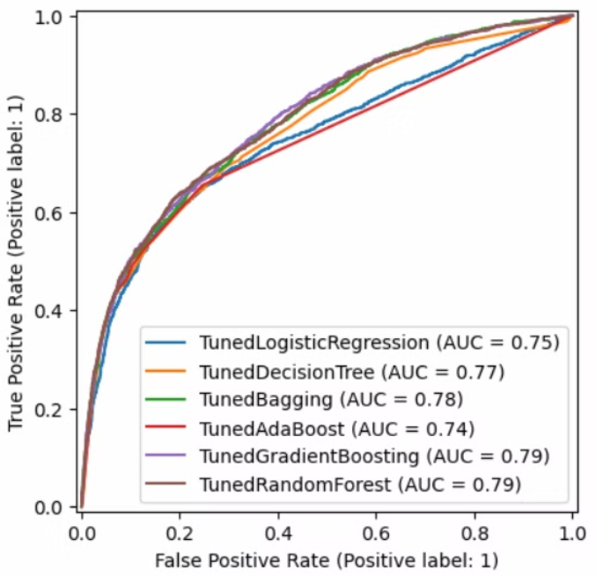
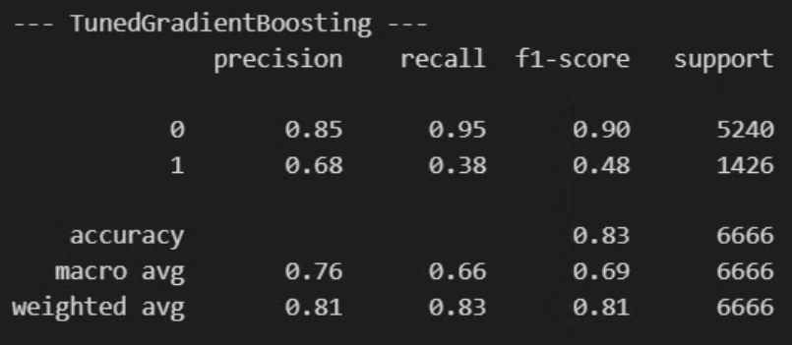
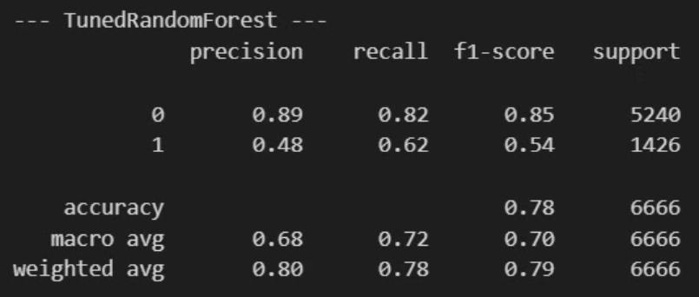
How Well Did Our Model Perform?

Slide 10

Next Steps
Deploy Model
1
Integrate the model into BestCard's credit risk system.
2
Pilot Program
Validate performance with real customer data.
Refine Strategies
3
Develop customized repayment plans for high-risk customers.
4
Continuous Monitoring
Update the model regularly with fresh customer data.
Notes:
1. Deploy the predictive model into BestCard’s credit risk system.
2. Start a pilot program with real customer data to validate performance.
3. Refine intervention strategies for high-risk customers.
4. Monitor and adjust the model to improve long-term accuracy.
5. Scale the model across all customer segments for maximum impact.

Slide 11






What Should BestCard Do?
Early Risk Detection
Flag high-risk customers before they default.
Targeted Interventions
Offer customized repayment plans to at-risk customers.
Smart Credit Limit Adjustments
Reduce limits for high-risk customers to prevent
over-borrowing.
Proactive Customer Support
Educate customers about responsible credit usage.
Continuous Monitoring
Update the model regularly with new data
Notes:
1. Early Risk Detection: Use our model to flag high-risk customers before they default.
2. Targeted Interventions: Offer customized repayment plans to at-risk customers.
3. Smart Credit Limit Adjustments: Reduce limits for high-risk customers to prevent over-borrowing.
4. Proactive Customer Support: Educate customers about responsible credit usage.
5. Continuous Monitoring: Update the model regularly with fresh customer data.

Slide 12

Business Benefits:
Why This Matters
Reduces financial losses
Improves cash flow
Enhances customer relationships
Strengthens regulatory compliance
Supports long-term profitability
Notes:
• Reduces financial losses by preventing high-risk lending.
• Improves cash flow through better repayment forecasting.
• Enhances customer relationships by offering personalized financial solutions.
• Strengthens regulatory compliance with better credit risk management.
• Supports long-term profitability by lowering default rates.

Slide 13

Conclusion
• Predictive analytics empowers BestCard to reduce financial risks.
• A data-driven approach helps identify who is at risk before
they default.
• Implementing these strategies will lead to lower default rates and higher profits.
Call to Action: Let’s integrate this model and start preventing defaults today!

